Slide 1
FIPA-ACL
COMP 40040: Agent-Oriented Software
Lecturer: Rem Collier
Email: rem.collier@ucd.ie

Slide 2
FIPA ACL: Introduction
FIPA is the official standards body for multi-agent systems
Its goal was (is) to standardise the concept of an agent and its underlying machinery.
Its goal was (is) to promote interoperability between technologies and systems.
FIPA membership includes many large multinationals (Alcatel-Lucent, Boeing, HP, IBM, Intel,…) and academic/government organisations and research institutes
The initial standards released by FIPA in 2000 included:
Agent Communication
Application Infrastructures
Agent UML
FIPA Standards: http://www.fipa.org/repository/standardspecs.html

Slide 3
FIPA ACL Structure
Performative (communicative act)
20 performatives in FIPA ACL
Housekeeping
e.g. Sender, Reply to, Reply-with, In-Reply-With
Content
the actual content of the message
Language
The language in which the content is written
Ontology
The ontology in which the message needs to be interpreted.

Slide 4
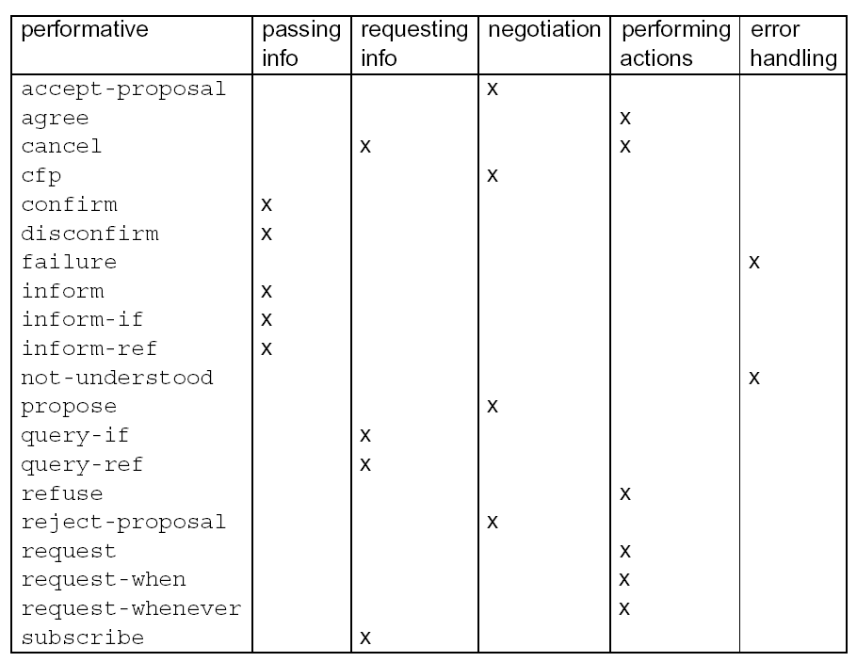
FIPA-ACL: Performatives

Slide 5
FIPA ACL: Message Structure
Transport-message: HTTP
Sender:
Transport-type: FIPA-HTTP
Transport-address: http://www.agentfactory.com:4444/
Transport-properties: none
Receiver:
Transport-type: FIPA-HTTP
Transport-address: http://www.ibeca.org:4444/
Transport-properties: none
Additional-attributes:
none
Envelope
Envelope:
Comprises of a collection of parameters
Contains at least the mandatory to and sender parameters
Message Body
The fully specified message in the chosen ACL syntax
Can be encoded (e.g. The FIPA Bit Efficient Encoding Mechanism).
Payload
(ACL message)
Notes:
5

Slide 6
FIPA ACL: Performative Semantics
 | Inform | Request
Content | statement | action
Precondition | Holds that the content is true. Intends that the recipient believe the content Does not already believe that the recipient is aware whether content is true or not | Intends action content to be performed Believes recipient is capable of performing this action Does not believe that sender already intends to perform action

Slide 7
FIPA ACL: Interaction Protocols
Ongoing conversations between agents fall into typical patterns.
In such cases, certain message sequences are expected, and at any point in the conversation, other messages are expected to follow.
In FIPA ACL, these patterns of message exchange are called protocols.
Each message can be annotated with a protocol identifier.
This provides valuable context for the receiver and helps it to
Understand how to respond to the message
(query-if :sender A
:receiver B
:content some-act
:protocol fipa-query-protocol
)

Slide 8
FIPA ACL: Interaction Protocols
Basic FIPA Interaction Protocols:
Propose Protocol
Query Protocol
Request Protocol
Cancel Meta-Protocol
Subscribe Protocol
More complex Protocols:
Recruiting Protocol
Brokering Protocol
Request When Protocol
English and Dutch Auctions, (Iterated) Contract Net (later)

Slide 9
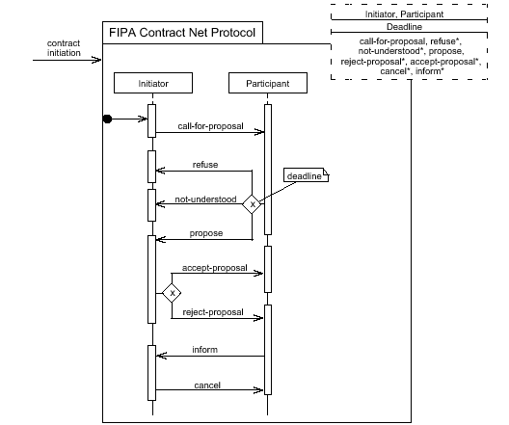
Insert: AUML Protocol Diagrams
Supports Parameterized Templates.
Messages constrained to communicative acts.
Optional AND, OR, XOR connectors for lifelines.
Multiple threads of interaction:
Concurrent: all together now
Decision: 0 or more
Selection: exactly 1

Slide 10
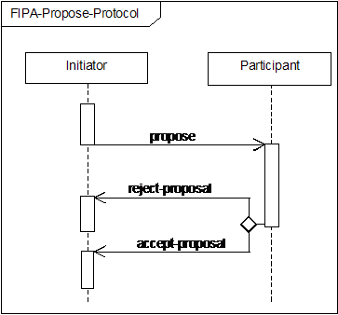
FIPA Propose Protocol
Initiator proposes that the participant perform some action.
The participant can:
Say no (reject-proposal)
Say yes (accept-proposal)
An accept-proposal message is typically followed by:
the execution of the agreed action
(if necessary) informing the initiator of the result of the action.

Slide 11
FIPA Propose Protocol
Robot BC45 asks robot XY29 to pick up box 432987.
(propose
:sender BC45
:receivers (set XY29)
:protocol fipa-propose
:language Prolog
:conversation-id 45
:content “pickup(432987)”)
(reject-proposal
:sender XY29
:receivers (set BC49)
:protocol fipa-propose
:language Prolog
:conversation-id 45
:content “pickup(432987)”)

Slide 12
FIPA Query Protocol
A robot checks whether there is beer in the fridge
(query-if
:sender robot
:receivers (set fridge)
:protocol fipa-query
:language Prolog
:content “have(beer)”)
(inform
:sender fridge
:receivers (set robot)
:protocol fipa-query
:language Prolog
:content “~have(beer)”)

Slide 13
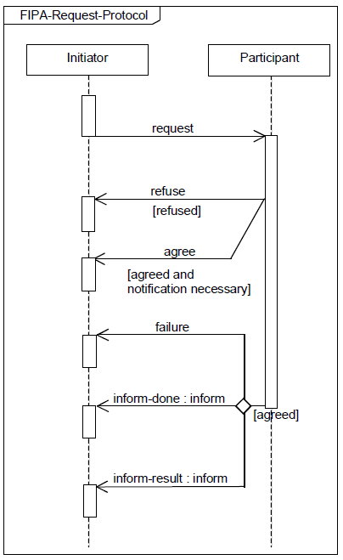
FIPA Request Protocol
Initiator requests that some task be performed
Participant either agrees to or refuses the request
Participant performs the task and tells the initiator:
Of the failure of the task
That the task is done
The result of the task

Slide 14
FIPA ACL: Example Messages
Rem asks the robot for a beer:
(request
:sender rem
:receivers (set robot)
:language ASTRA
:content “get(beer)”
)
(refuse
:sender robot
:receivers (set rem)
:language ASTRA
:content “get(beer)”
)
(request
:sender rem
:receivers (set robot)
:language ASTRA
:content “get(beer)”
)
(agree
:sender robot
:receivers (set rem)
:language ASTRA
:content “get(beer)”
)
(inform
:sender robot
:receivers (set rem)
:language ASTRA
:content “have(beer)”
)

Slide 15
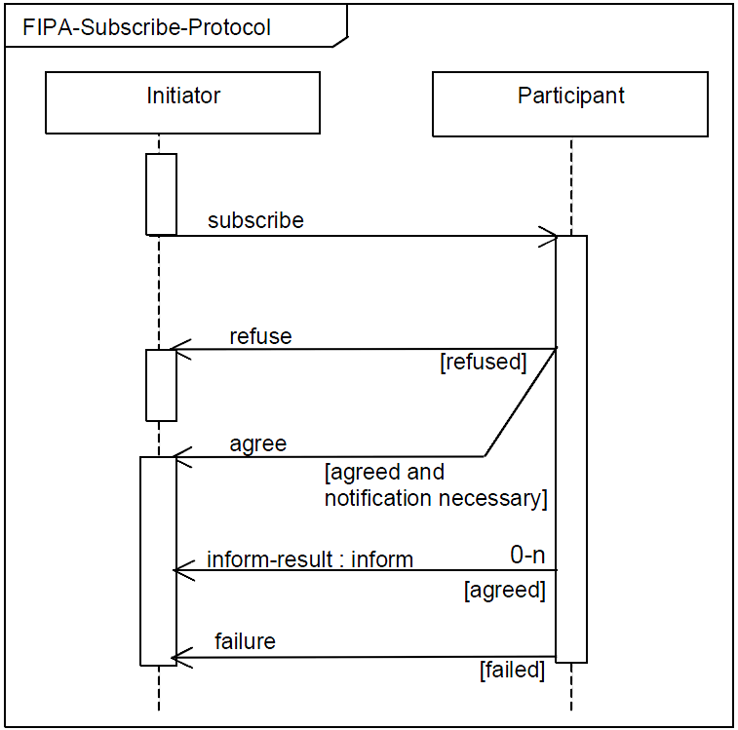
Example: FIPA Subscribe Protocol
Initiator subscribes to the participant.
Participant either agrees or refuses subscription
Participant informs initiator of any information relating to the subscription or sends a failure message if necessary.

Slide 16
FIPA Subscribe Protocol
A book_launcher agent offers a subscription service for information about new books:
(subscribe
:sender bob :receivers (set book_launcher)
:protocol fipa-subscribe
:language ASTRA
:content “new_books([\”fantasy\”,\”cooking\”])”)
(agree
:sender book_launcher :receivers (set bob)
:protocol fipa-subscribe
:language ASTRA
:content “new_books([\”fantasy\”,\”cooking\”])”)
(inform
:sender book_launcher :receivers (set bob)
:protocol fipa-subscribe
:language ASTRA
:content “book(\”fantasy\”,
\”Harry Potter and the Philosophers Stone\”,
\”J.K.Rowling\”)”)

Slide 17
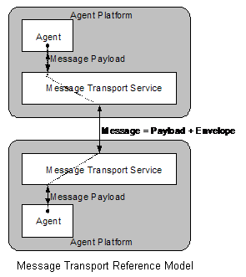
FIPA Transport management
FIPA also defines how messages are sent and received.
This is done using a Message Transport Service:
SC00075 – FIPA Agent Message Transport Protocol over IIOP Specification.
SC00084 – FIPA Agent Message Transport Protocol over HTTP Specification.
These are deployed on an agent platform:
SC00001 – FIPA Abstract Architecture Specification
SC00023 – FIPA Agent Management Specfication

